Slide 1
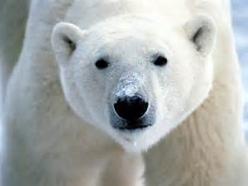
Polar Bears

Slide 2
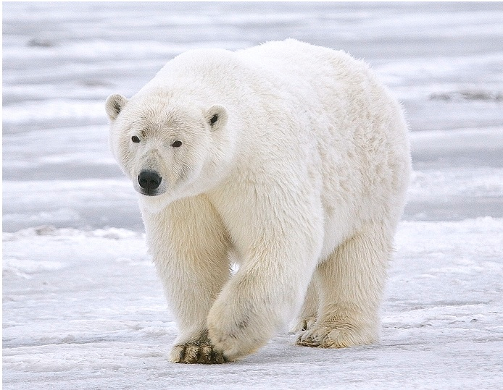
It is the largest carnivore (meat eater) that lives on land

Slide 3
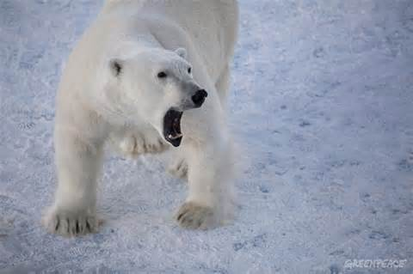
Polar bears have black skin

Slide 4
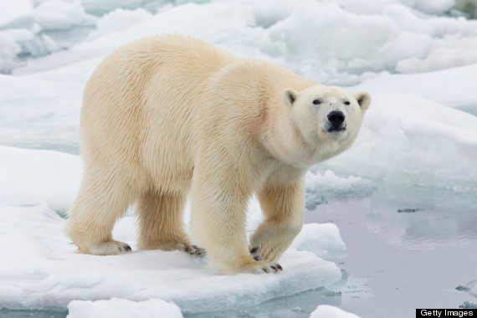
Male polar bears can weigh up to 1500 pounds

Slide 5
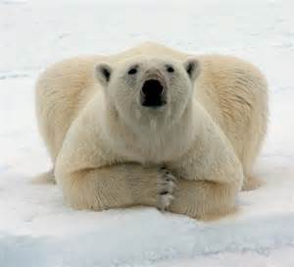
It is the largest carnivore (meat eater) that lives on land

Slide 6
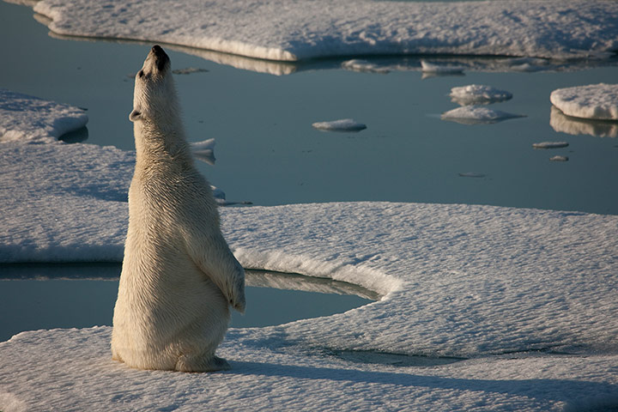
Polar bears have an excellent sense of smell, with the ability to find seals nearly a mile away

Slide 7
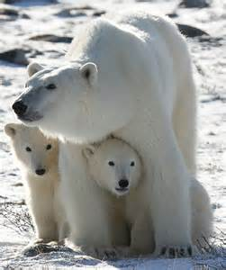
Polar bear mothers usually have twins. Polar bear cubs weigh just over one pound at birth! They are about the size of a stick of butter.

Slide 8
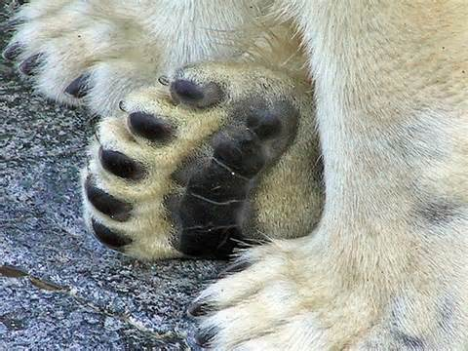
Polar bears have wide front paws with webbed toes that help them swim.

Slide 9
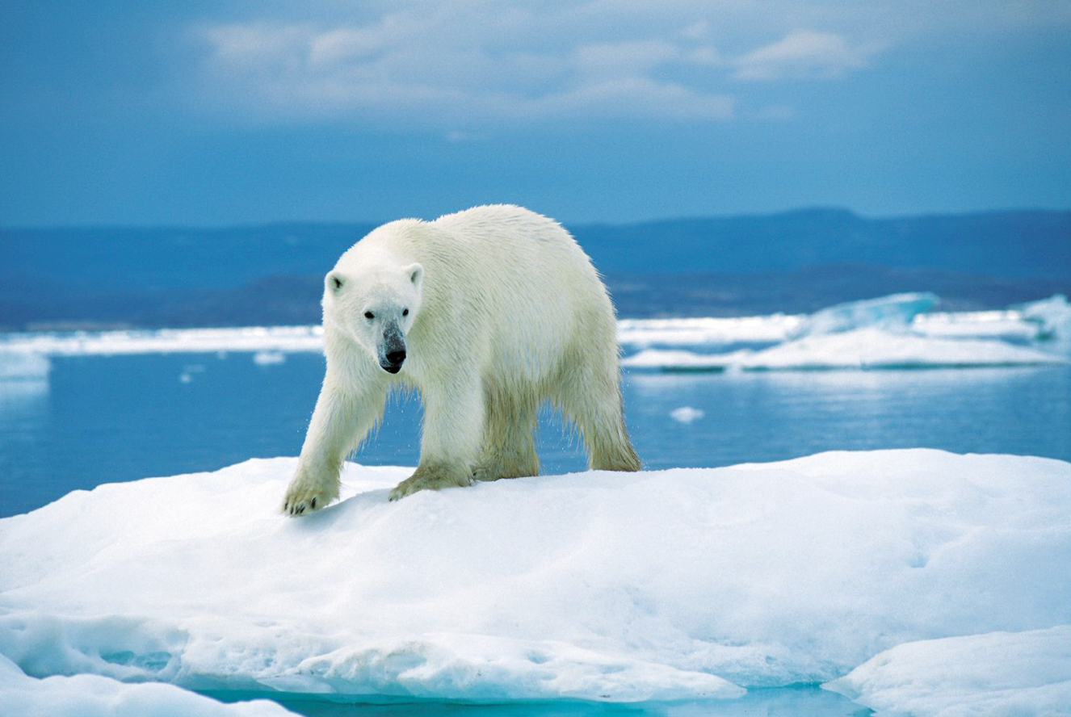
Polar bears are at risk in a warming world. They need sea ice to hunt seals, and the sea ice is melting

Slide 10
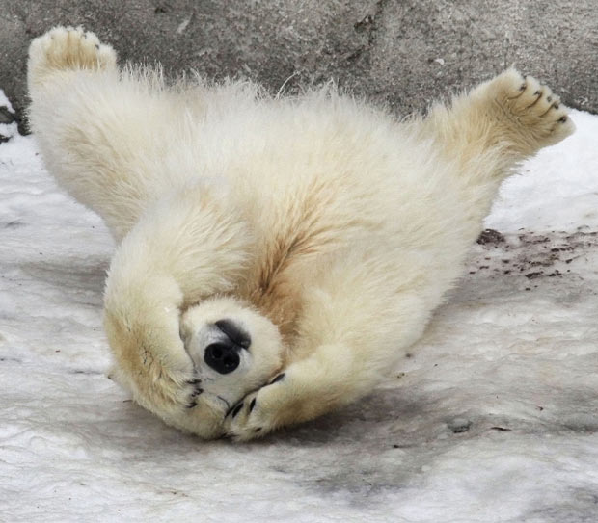
Scientists are worried that one day the polar bears will be extinct because they won’t have anywhere to live.

Slide 11
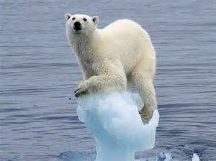

Slide 12
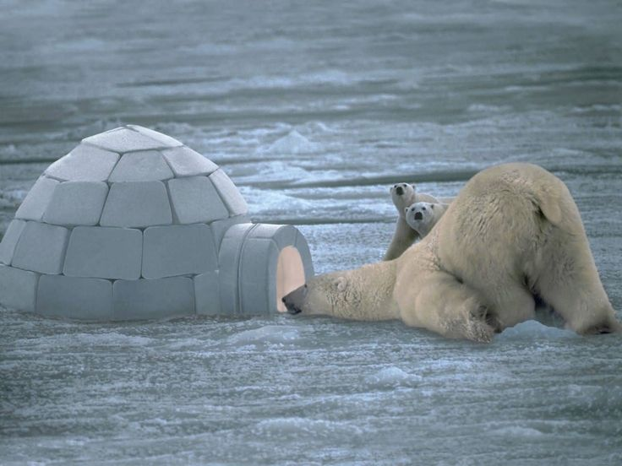

Slide 13
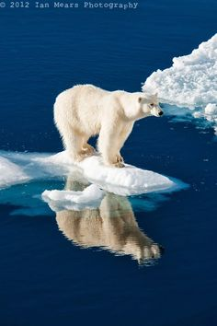
How to help Polar Bears:
Recycle
Turn off lights and
unplug things
Use car less – walk,
or ride bike

